Slide 1
IB Theme: EMpathy

Slide 2
Empathy vs. Sympathy
What separates empathy from sympathy is one word,
“Understanding”

Slide 3
Empathy vs. Sympathy
Discussion question: Can humans learn to be more empathetic?
According to scientific research, you can by:
Be curious
Acknowledge bias
Listen Actively
Connect with diverse people
Put yourself in other’s shoes

Slide 4
Personality “Categories”
Birth Order
First
Second
Third
Only
Horoscope
Capricorn, Aquarius
Aries, Taurus
Gemini, Leo
Pisces, Cancer
Libra, Scorpio
Sagitarious, Virgo

Slide 5
The “Other Side” of Personality
Personality Disorder is a mental health condition where people have a lifelong pattern of seeing themselves and reacting to others in ways that cause problems.
People with personality disorders often have a hard time understanding emotions and tolerating distress. And they act impulsively.
This makes it hard for them to relate to others, causing serious issues, and affecting their family life, social activities, work and school performance, and overall quality of life.

Slide 6
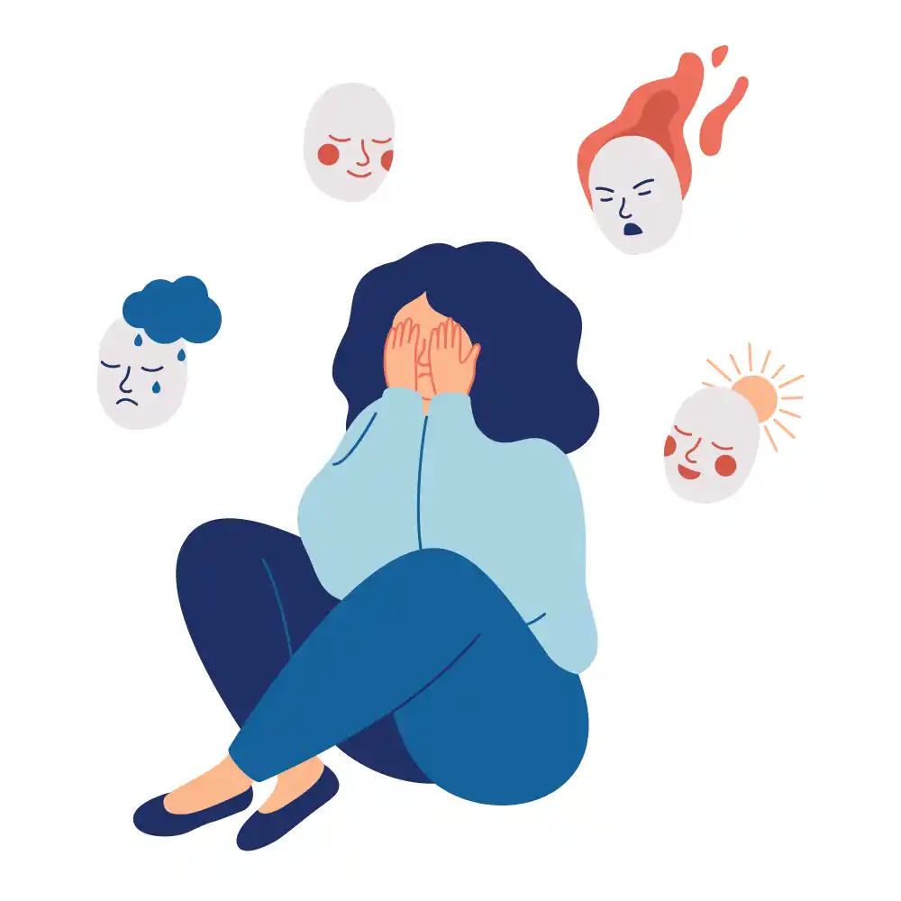
Diagnosing Personality Disorders
Mental Health professionals, like pyschologists and counselors, use the official “checklists” in the trusted reference guide to guage whether or not a patient has a mental disorder.
America: The DSM-5 (updated about 10-15 years)
China: CCMD-3 which is more like the UK’s ICD

Slide 7
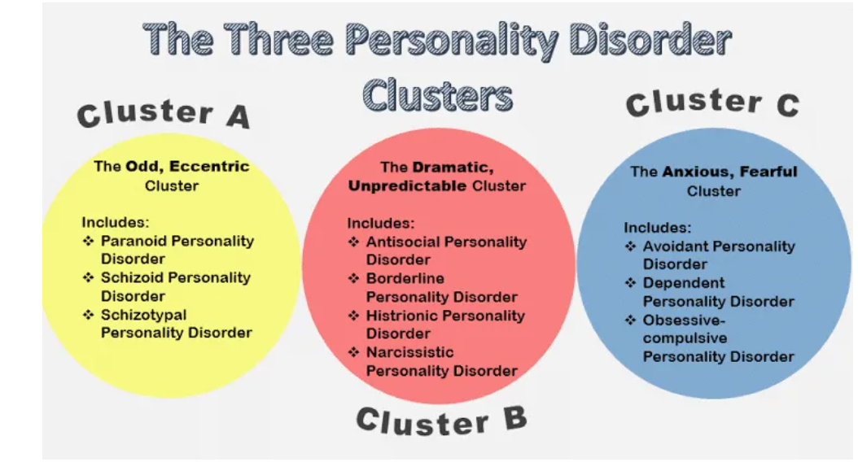

Slide 8

Check discussion questions

